Slide 1






BB84 QUANTUM KEY DISTRIBUTION FINITE-KEY SECURITY ANALYSIS ON REALISTIC HARDWARE
By Mohak Rathod
Team- QuantumExp

Slide 2
THE PROBLEM - WHY WE NEED QUANTUM CRYPTOGRAPHY
Classical Cryptography
Based on Assumptions“Factoring is hard”
Quantum computers will break it
“Store now, decrypt later” threat
Adversaries collect encrypted data
Quantum Cryptography
Based on Physics Laws of Quantum Mechanics
Quantum Proof
Information theoretic security
Provably secure, not just "hard"

Slide 3
THE RESEARCH GAP I ADDRESSED
What Academic Paper Show:
BB84 is information theoretically secure
Asymptotic key rate: r= 1- h2 (QBER)
Assumes: ∞ qubits, perfect hardware
In Reality
Quantum computers are Expensive
Can only send finite blocks (100-1000 qubits)
Hardware has noise (~0.1-1% error rate)
Critical Questions:
How many qubits do I ACTUALLY need?
What's the secure key length with realistic noise?
When does finite-size penalty dominate?

Slide 4
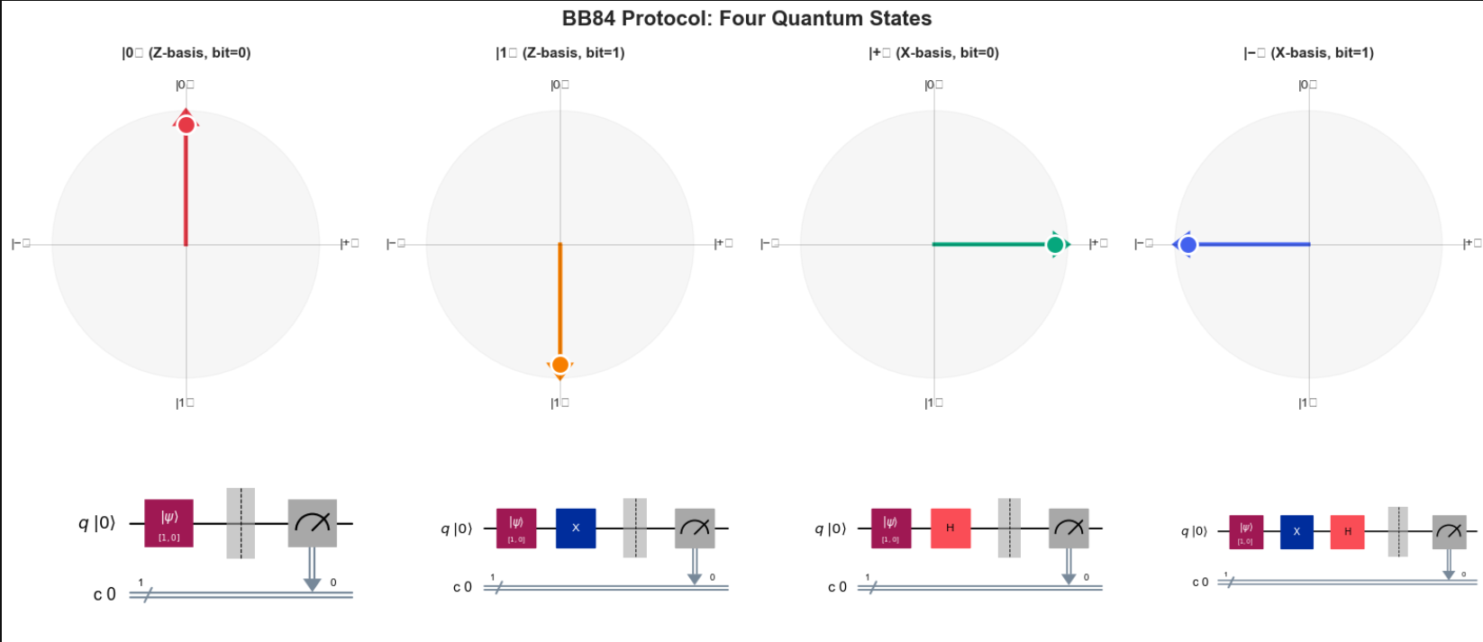
BB84 PROTOCOL - HOW IT WORKS

Slide 5
BB84 PROTOCOL - HOW IT WORKS
The Protocol:
Step 1: Alice prepares random qubits [0,1,0,1,1,0,...] → bits [Z,X,Z,X,Z,X,...] → bases
Step 2: Quantum transmission |0⟩,|+⟩,|0⟩,|−⟩,|1⟩,|+⟩,... → to Bob
Step 3: Bob measures in random bases [Z,Z,X,X,X,Z,...] → his choices
Step 4: Classical sifting Keep only matching bases (~50% survive)
Step 5: Error estimation (QBER) If QBER < 11% → Secure If QBER ≥ 11% → Eve detected, ABORT

Slide 6
BB84 PROTOCOL - HOW IT WORKS
Why Eve Can't Cheat
Eve intercepts qubit → Must measure it
Measures in WRONG basis 50% of time
Disturbs quantum state → Creates errors
Alice & Bob detect errors → Catch Eve!

Slide 7
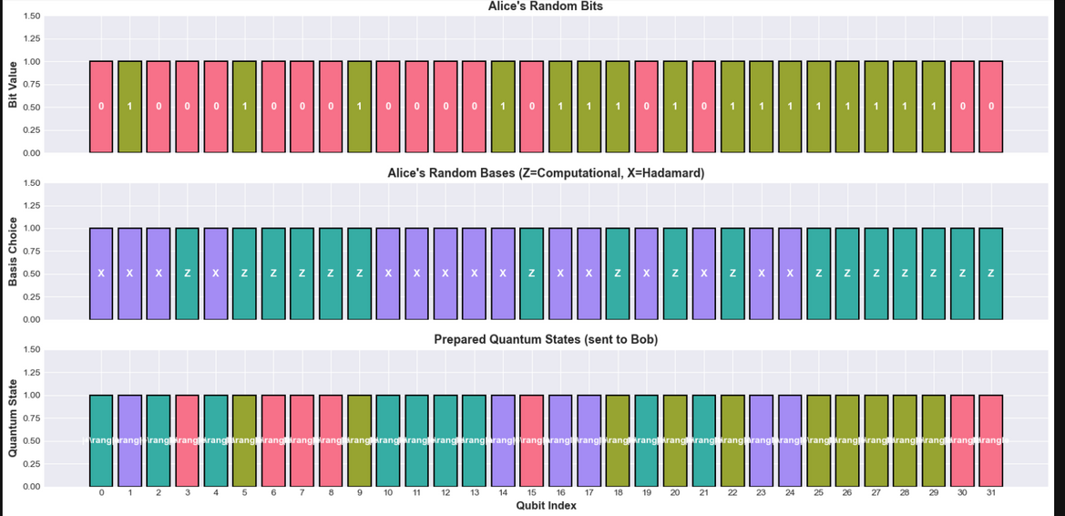
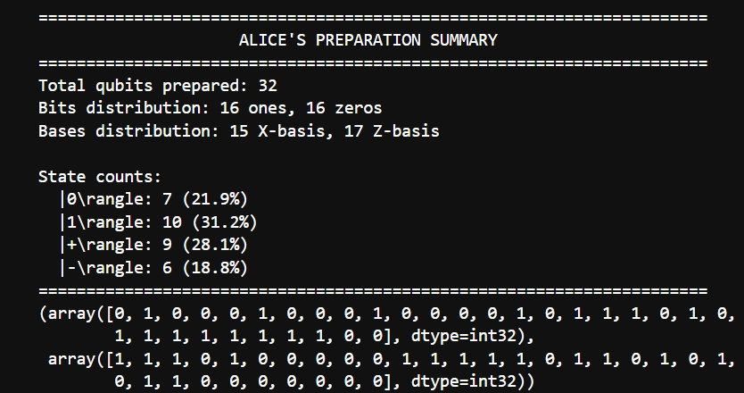
MY IMPLEMENTATION - COMPLETE FINITE-KEY ANALYSIS
Alice's Preparation

Slide 8
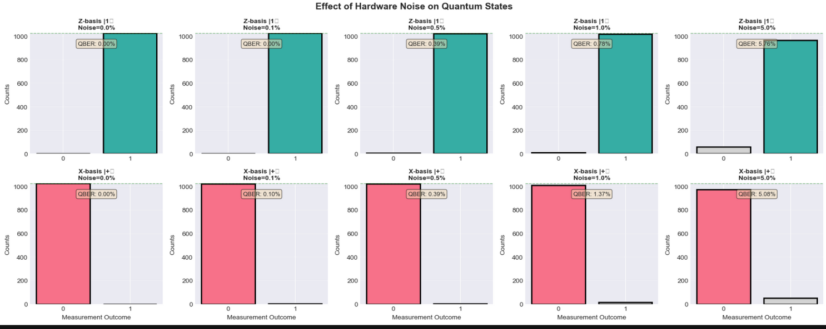
NOISE MODEL
Key Observation:
As noise increases, QBER rises, reducing secure key rate via binary entropy (h₂(QBER)).

Slide 9
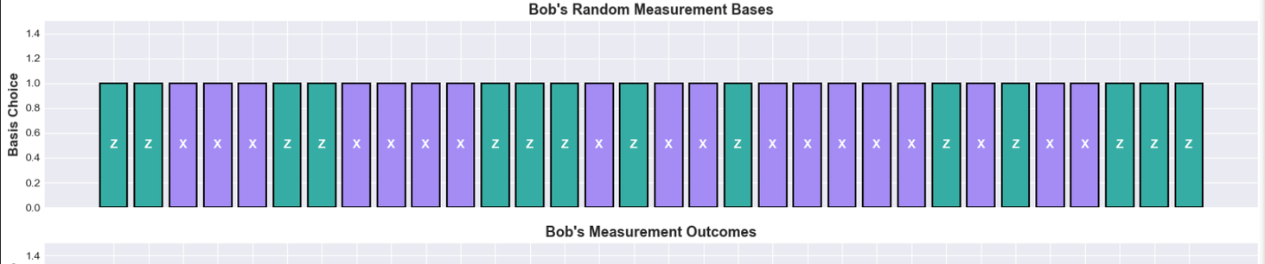
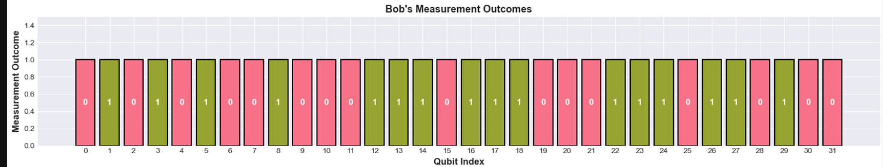
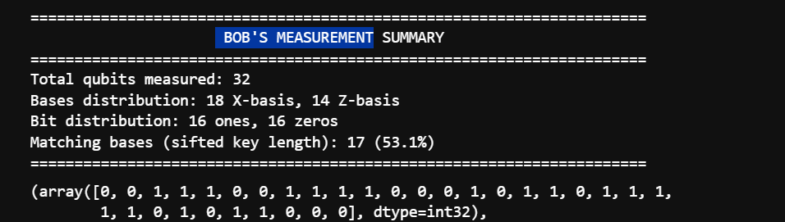
BOB'S MEASUREMENT

Slide 10
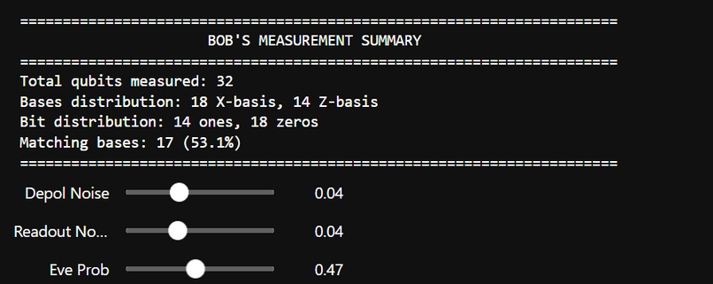
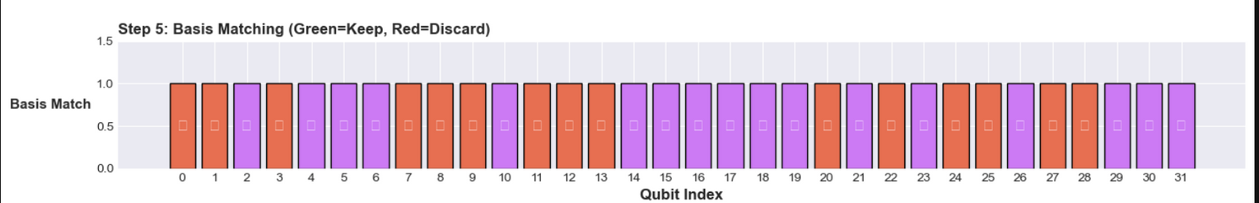
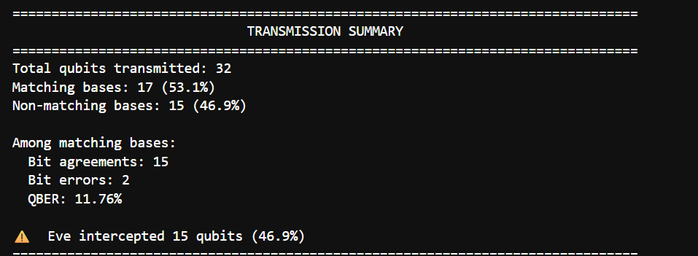
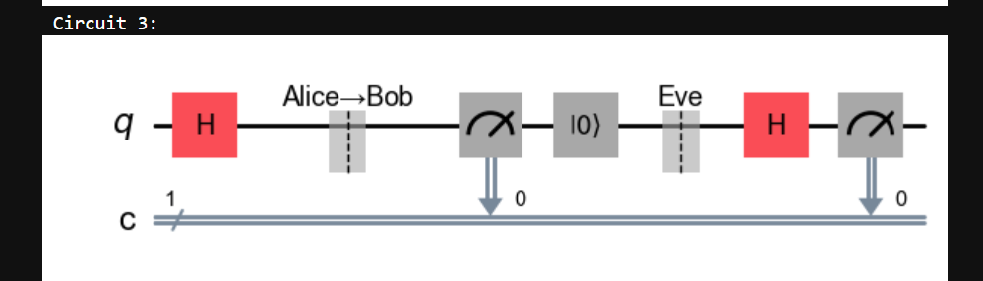
QUANTUM TRANSMISSION WITH NOISE

Slide 11
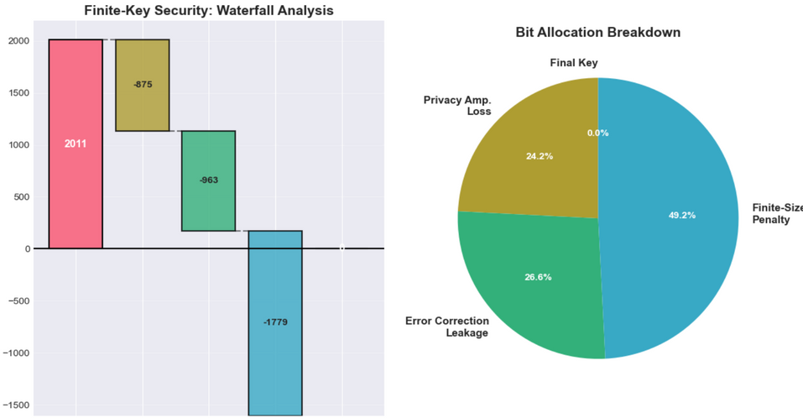
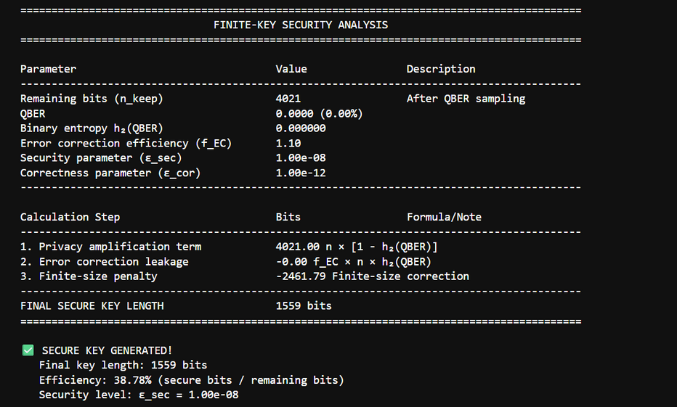
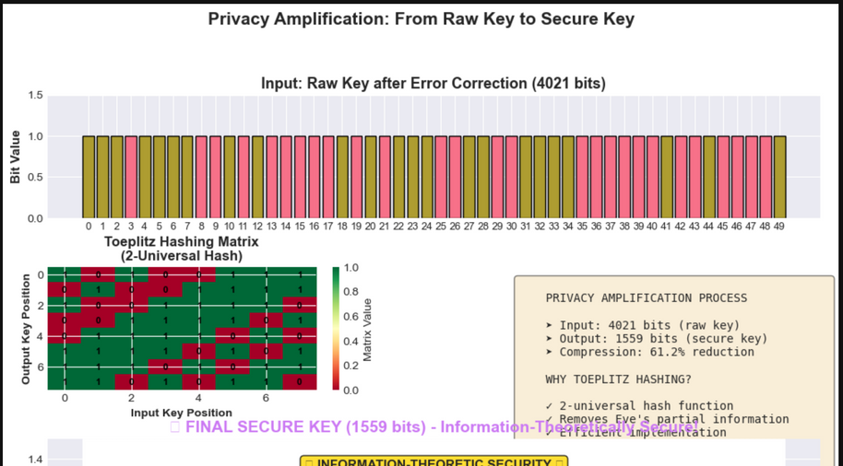
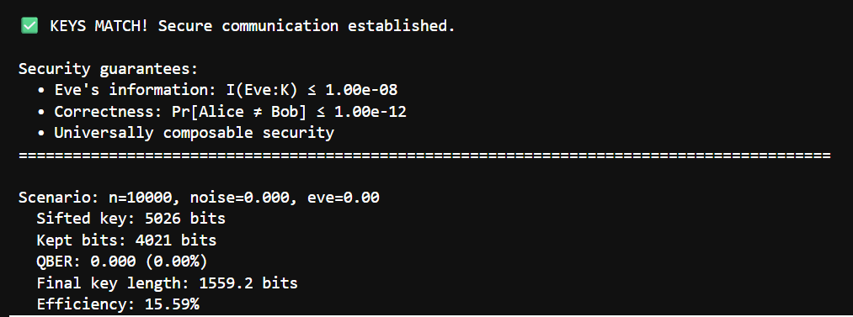
BB84 - FINITE KEY ANALYSIS

Slide 12
ANALYSIS FINDINGS
First, block size matters. With 64 qubits, you get almost nothing—the finite-size penalty eats your key. At 256 qubits, you reach the minimum viable size with about 35 secure bits. At 512 and 1024, you approach the asymptotic rates from textbooks. This answers the practical question: don't try QKD with less than 256 qubits.
Second, hardware quality is critical. We tested different noise levels. At 1% noise, you get 2% QBER—still secure. At 5% noise, you hit 10% QBER, dangerously close to the 11% security threshold. Current IBM quantum computers have about 99.5 to 99.9% gate fidelity—barely good enough. This shows QKD needs high-quality hardware.
Third, eavesdropping is detectable. Even if Eve intercepts just 5% of qubits, the QBER increases by 1.3 percentage points—clearly measurable. At 10% interception, it's obvious. This demonstrates the quantum advantage: unlike classical crypto where eavesdropping is invisible, quantum mechanics makes it physically detectable."

Slide 13
THANK
YOU

